Slide 1
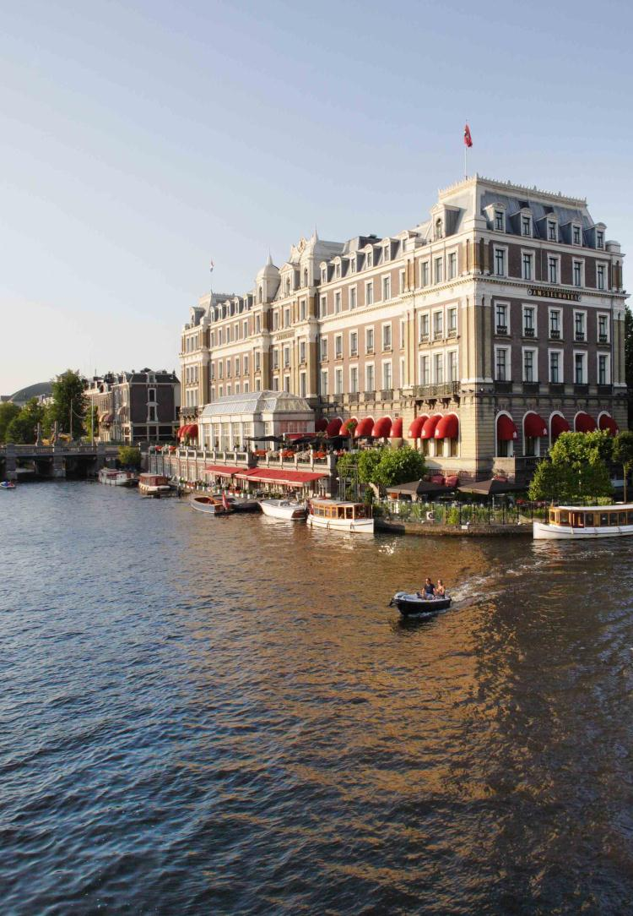
InterContinental
Amstel Amsterdam
Notes:
InterContinental Amstel Amsterdam
Well know hotel in The Netherlands. Most famous in Amsterdam
Known as the Amstel Hotel since the hotel is building on the banks of the Amstel River
Opened it’s doors in 1867. Almost celebrating 150 years of hospitality

Slide 2
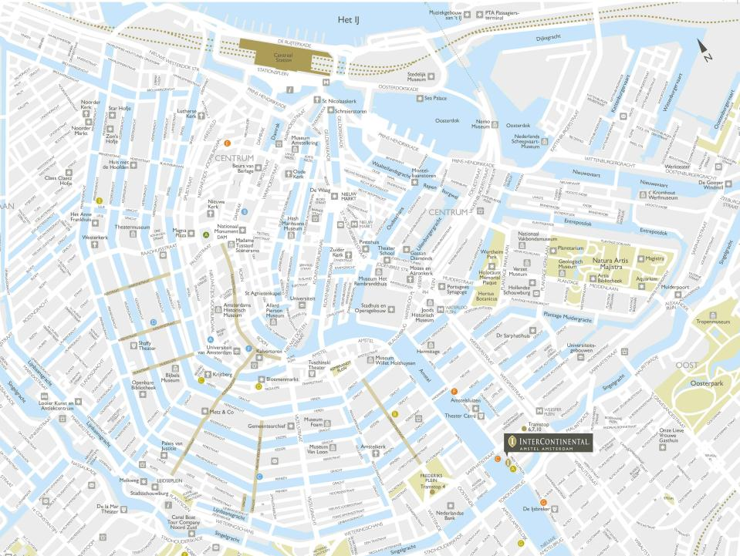
Schiphol Airport: 25 km – 20 minutes by car
Central Station: 3 km – 10 minutes by car
Amsterdam RAI: 4 km – 12 minutes by car
Amsterdam City Centre - Map
Notes:
Great location.
You can walk everywhere. ‘Rijks musem’ and Van Gogh musem are located on a 15 minutes walking distance.
UNESCO listed canals are just a step away
Area is very luxurious and quiet at night.
Easy to reach from airport (30 min)/ Central Station (10 min)/ Cruiseboat terminal (10 min)

Slide 3
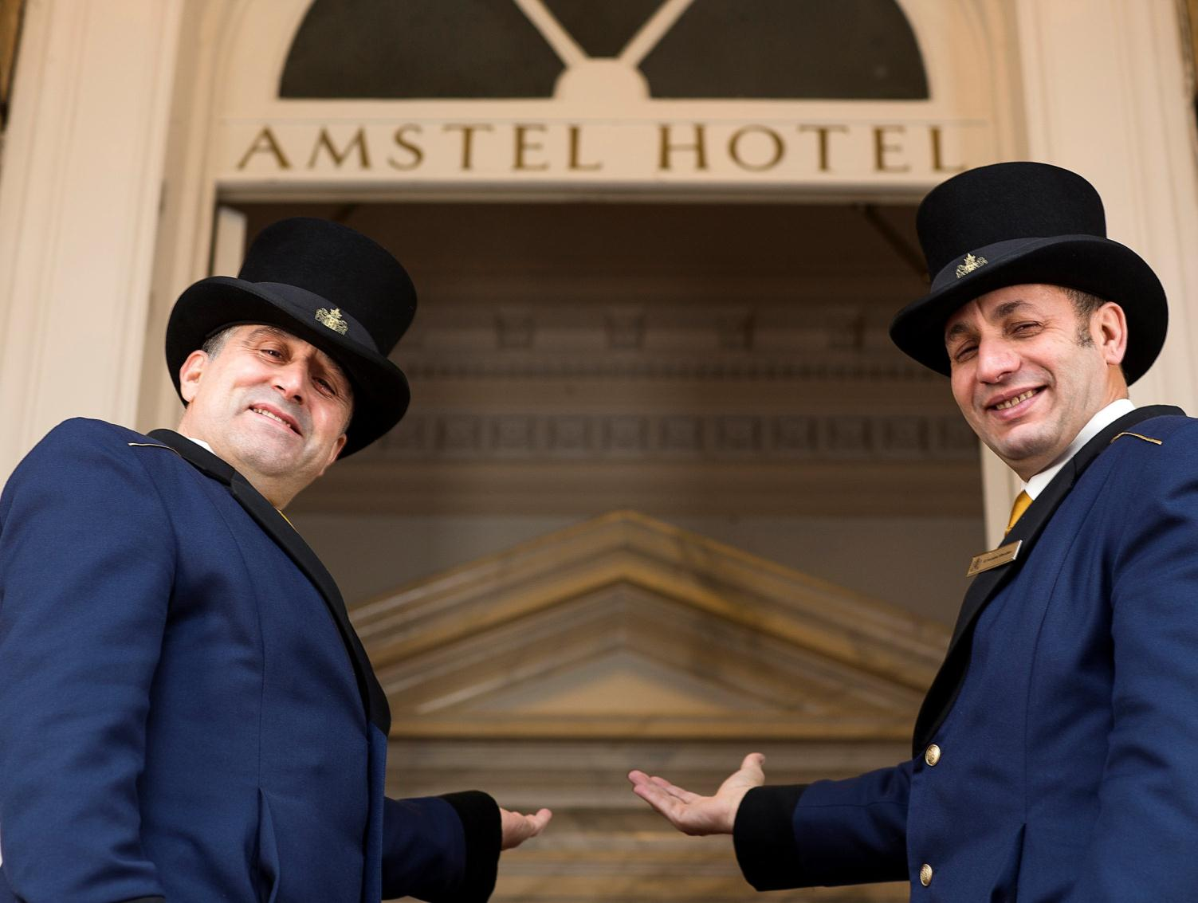
Welcome

Slide 4
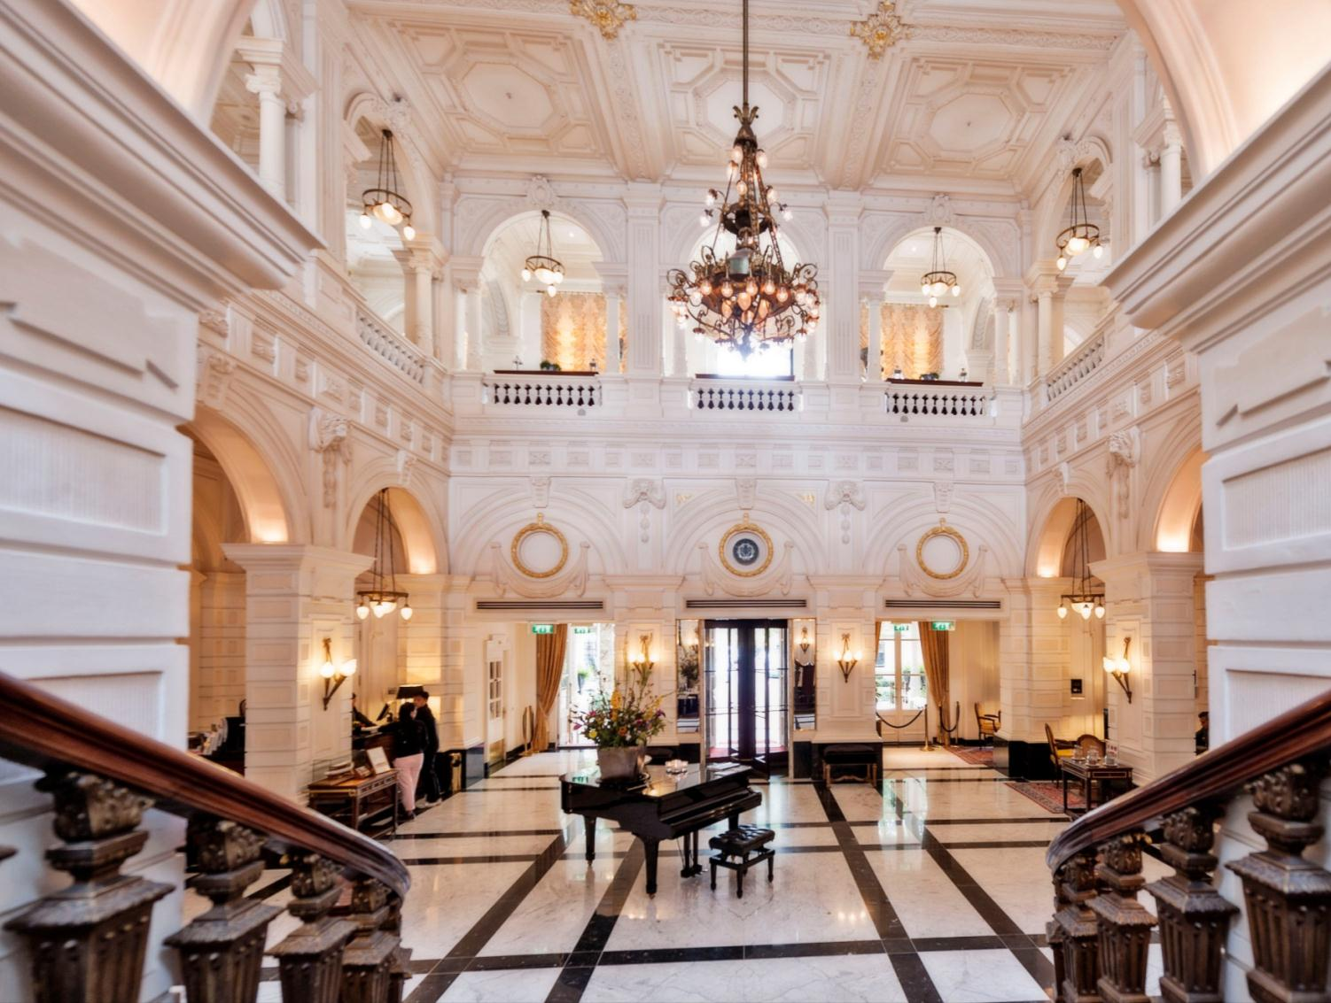
Lobby
Notes:
Historical Hotel – Lobby Area

Slide 5
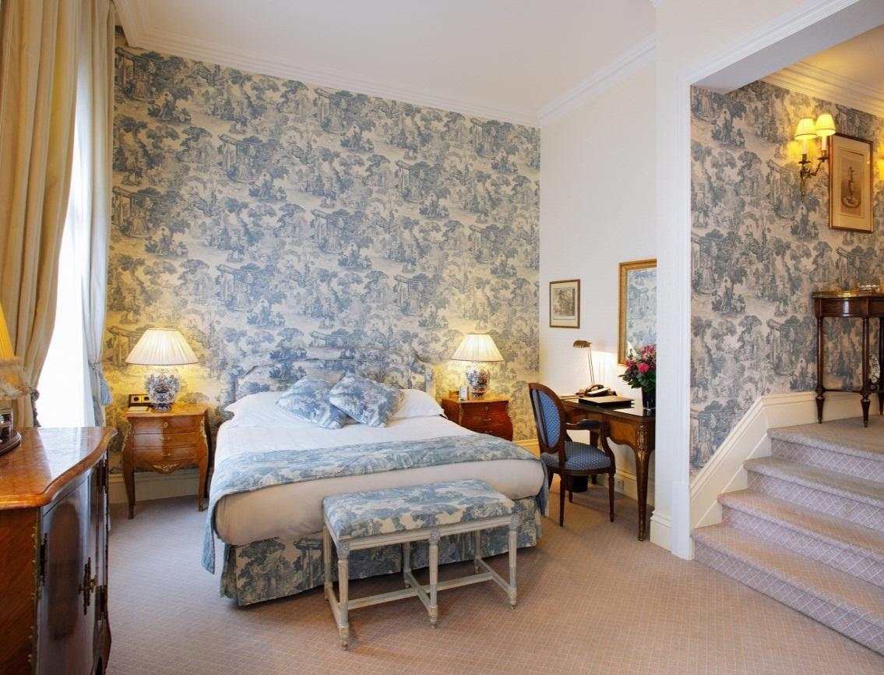
Over 600 Canals
Executive Room
Notes:
Entry Level room – 35m2, largest entry level room in Amsterdam! Spacious, lots of storage, high ceiling, large windows which can be opened fully.

Slide 6
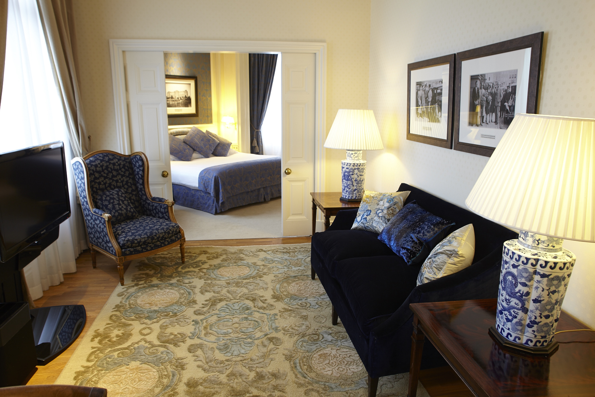
Suite
Notes:
2 or 3 bedroom Presidential Suite. 137m2. Spacious corner suite overlooking the Amstel River. 1 King + 1 Twin + 1 Living/ dining which can be converted into a King room if necessary.

Slide 7
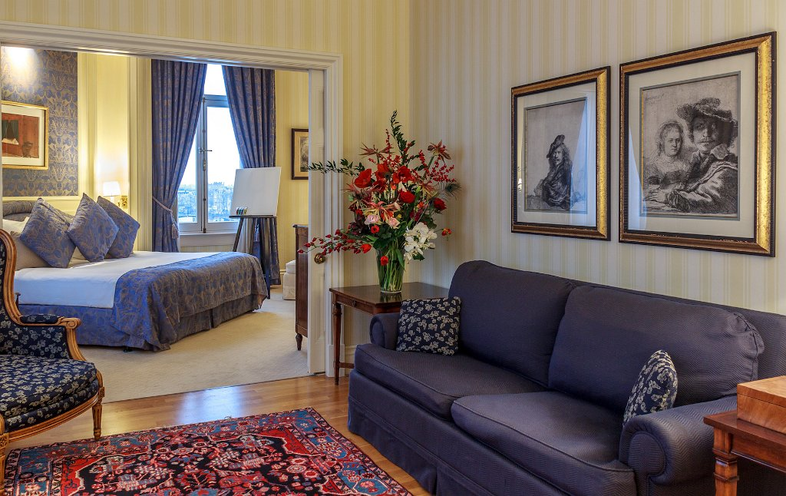
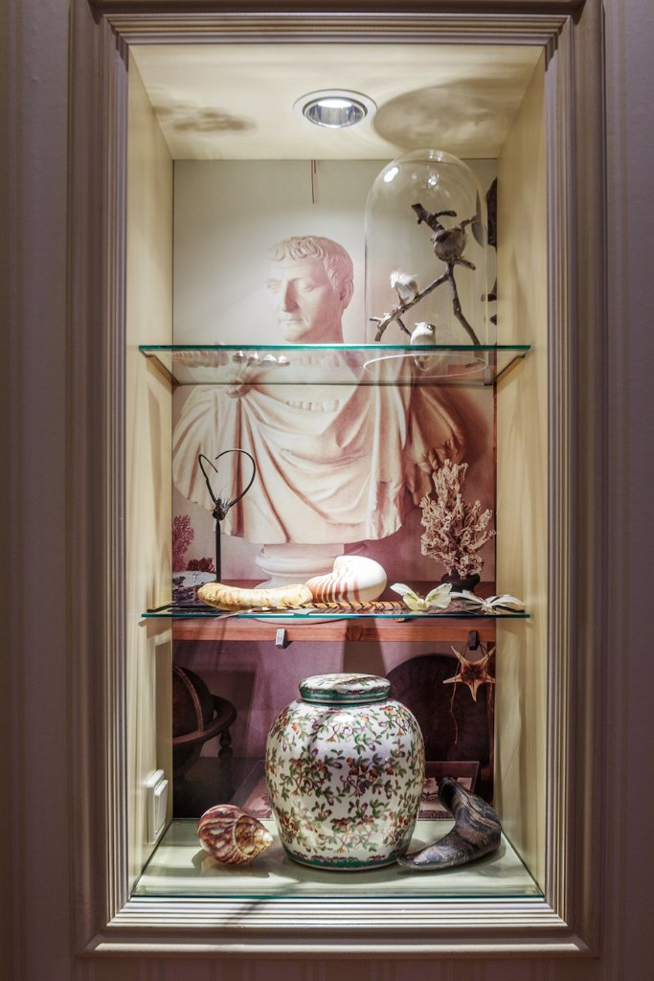
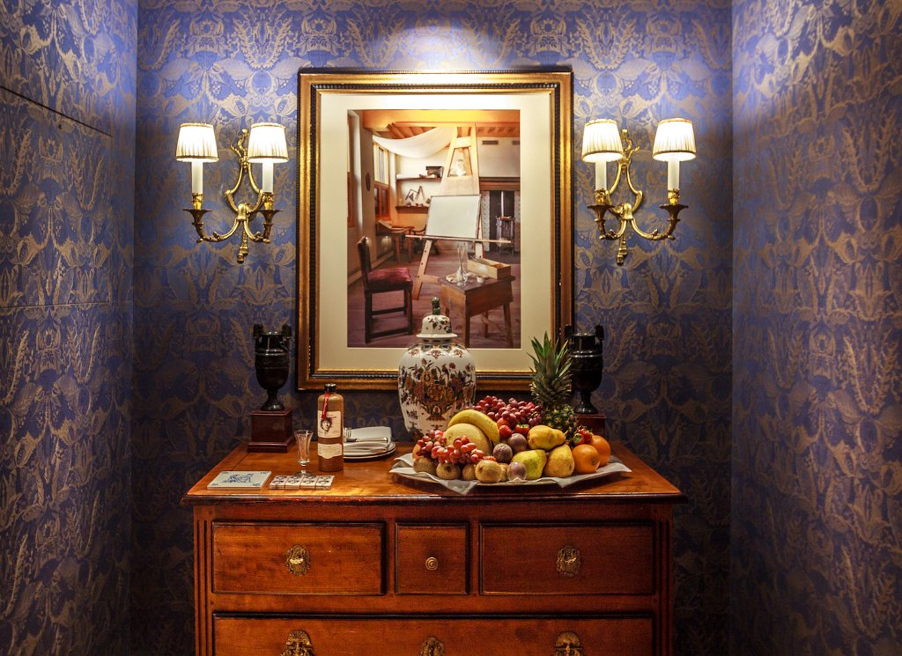
Brand NEW Rembrandt Suite

Slide 8
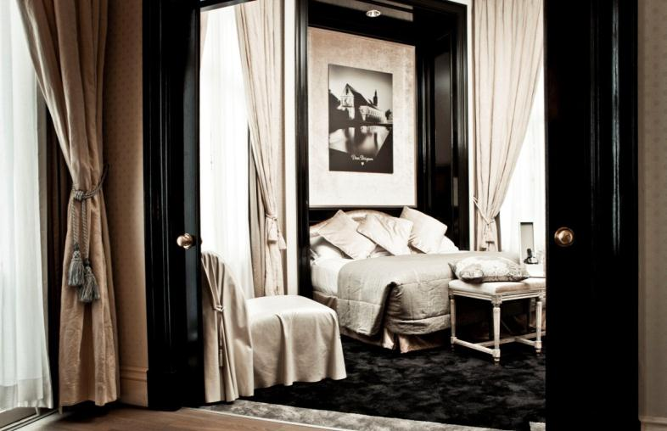
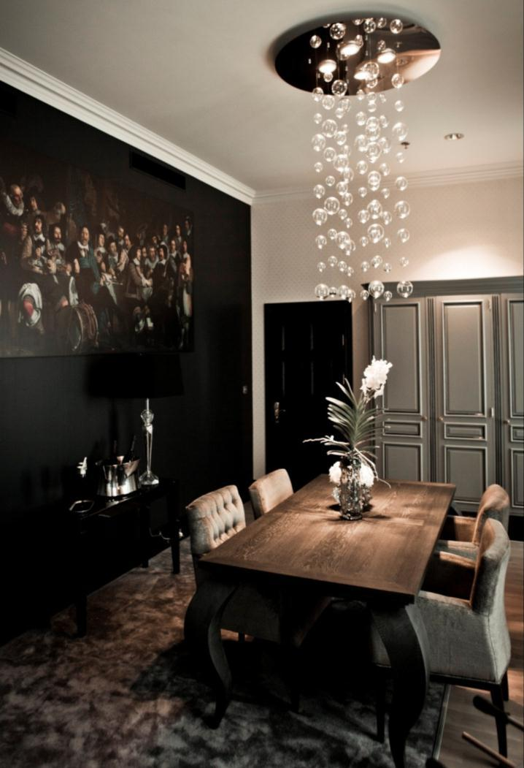
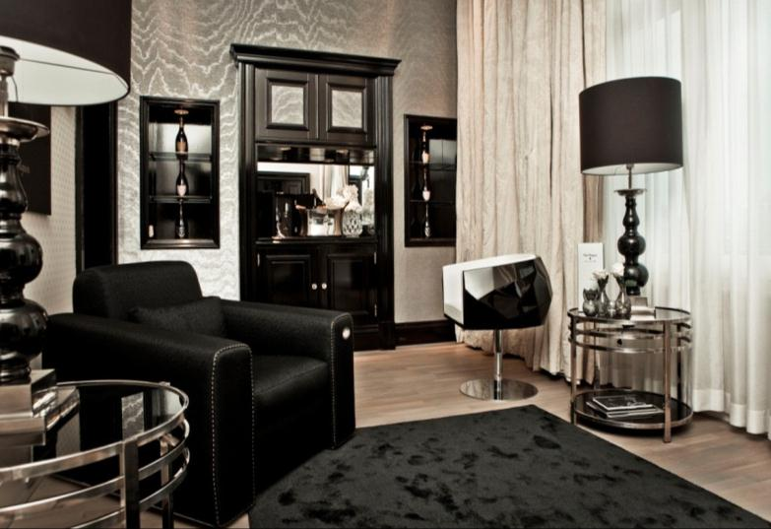
Dom Perignon Suite
Notes:
World’s first Dom Perignon Suite. 100m2, 1-bedroom suite. Comes with a bottle of 2004 vintage Dom Perignon Champagne and special welcome amenities.

Slide 9
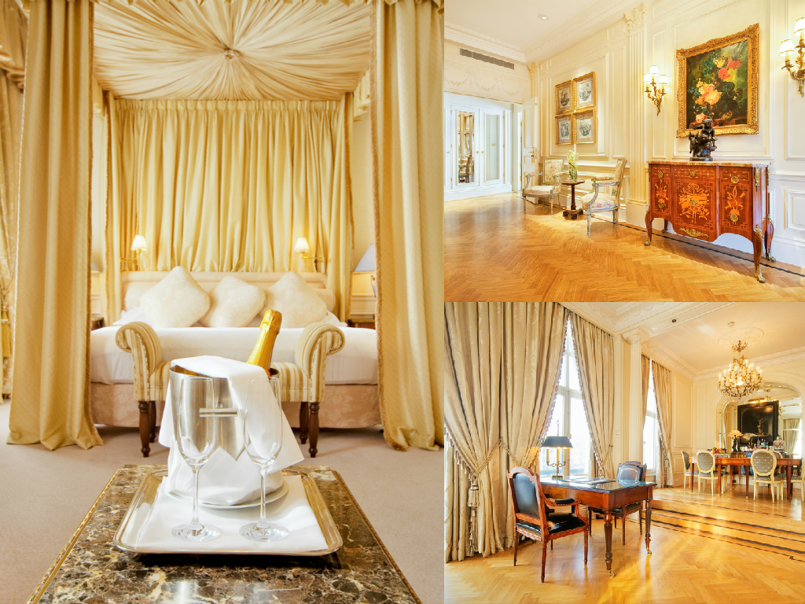
Royal Suite
Notes:
Royal Suite. 116m2 1- bedroom.

Slide 10
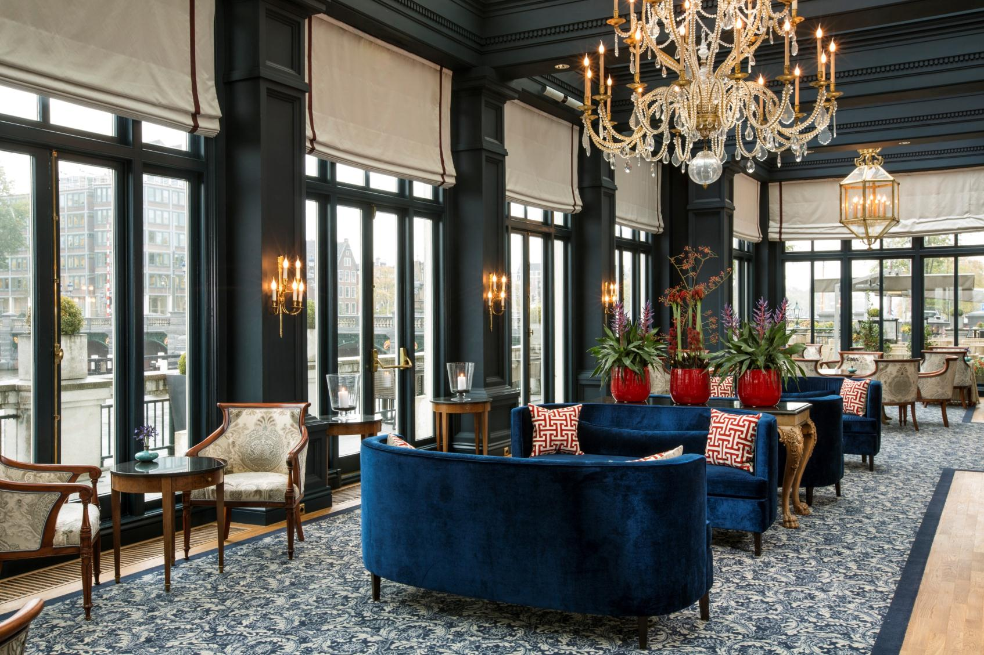
Lounge
Notes:
Amstel Lounge. Overlooking Amstel River. Guest can enjoy our award winning Royal Afternoon Tea here.

Slide 11
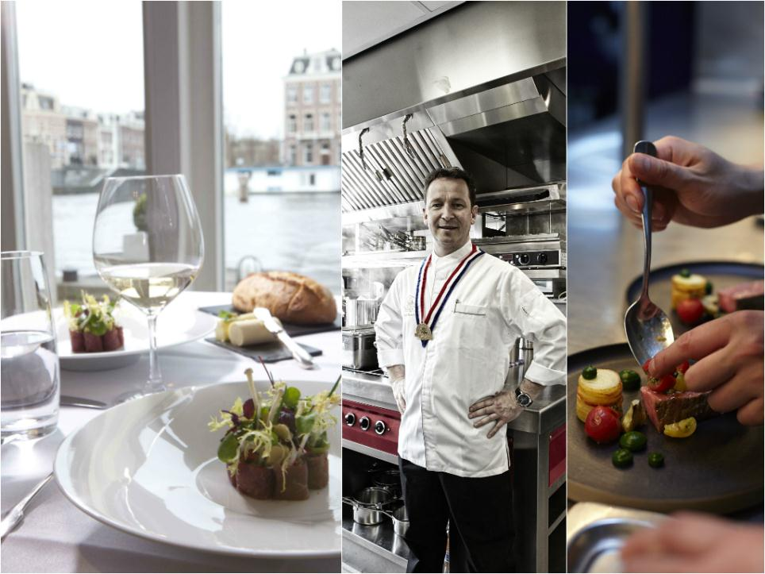
La Rive – 1 Michelin Star Restaurant
Notes:
Michelin star restaurant La Rive. 1 Michelin Star. Open 7 days for dinner.

Slide 12
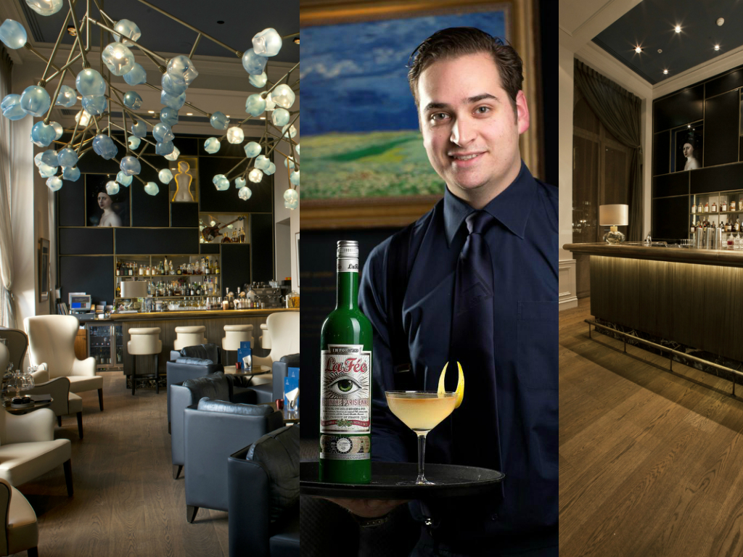
A bar
Notes:
Newest Cocktailbar in town. All cocktails & food are inspired by authentic local ingredients.

Slide 13
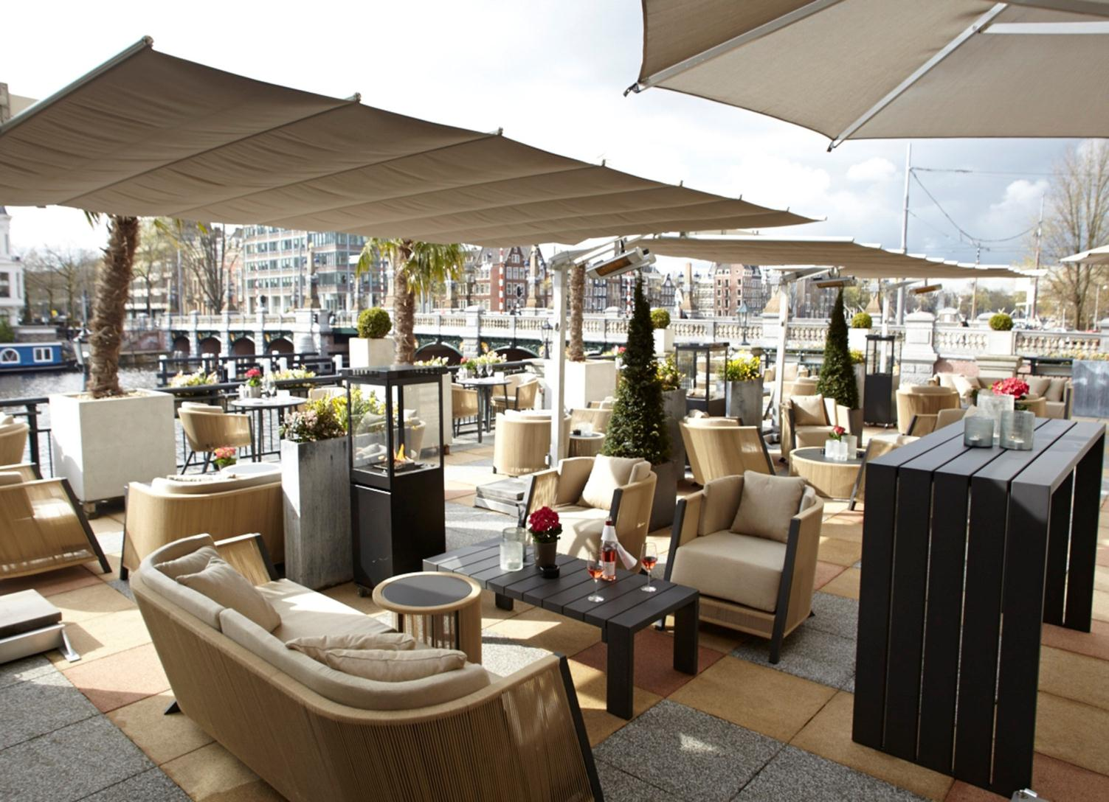
A Bar Terrace
Notes:
Amazing terraces overlooking Amstel River. Very comfortable and secure.

Slide 14
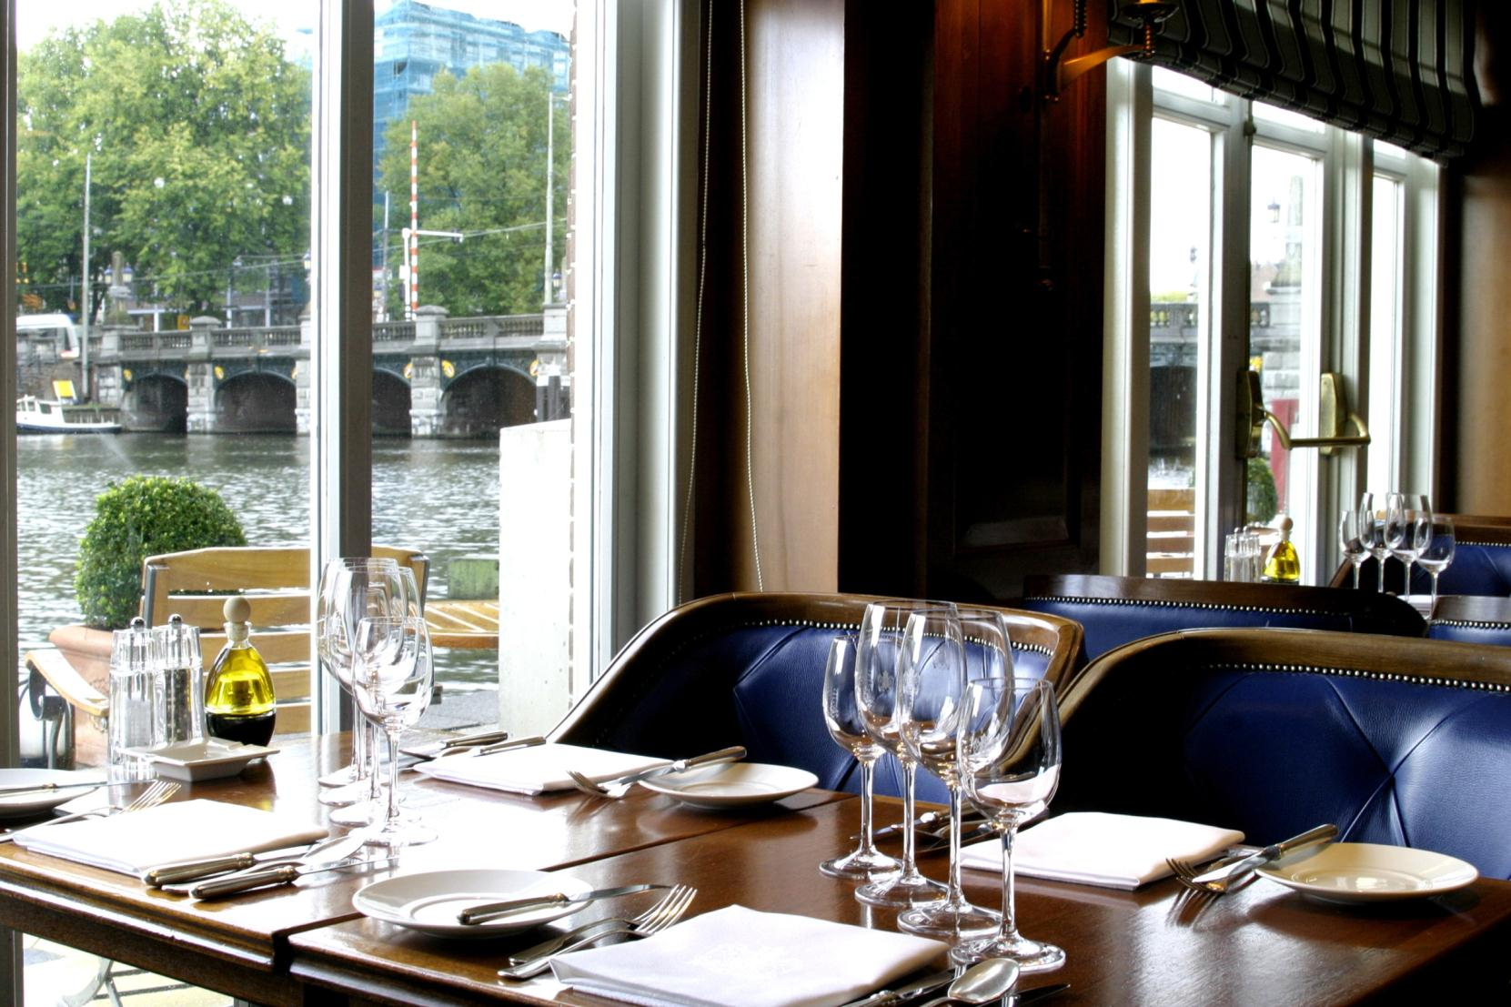
Amstel Brasserie
Notes:
Amstel Brasserie. Open 7 days a week for both lunch & dinner. Brasserie style food.

Slide 15
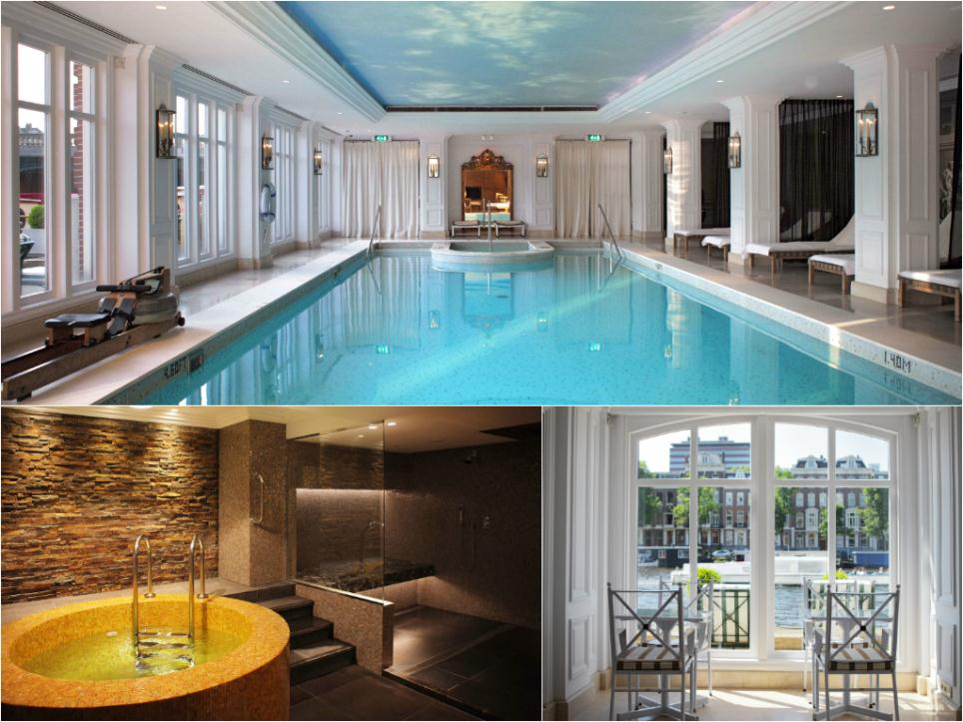
Health Club & Wellness
Notes:
Health & Fitness club. Indoor pool, sauna, steam bath, fitness center, outside terrace. Included for all hotel guests.

Slide 16
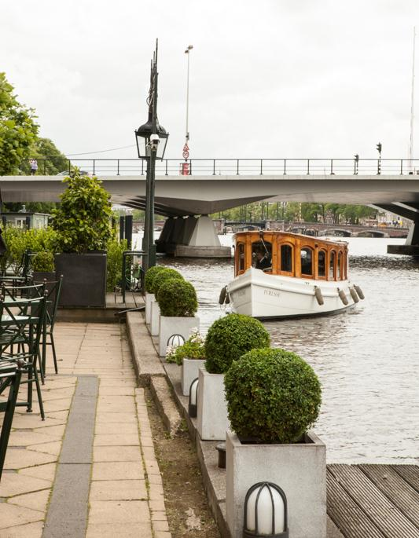
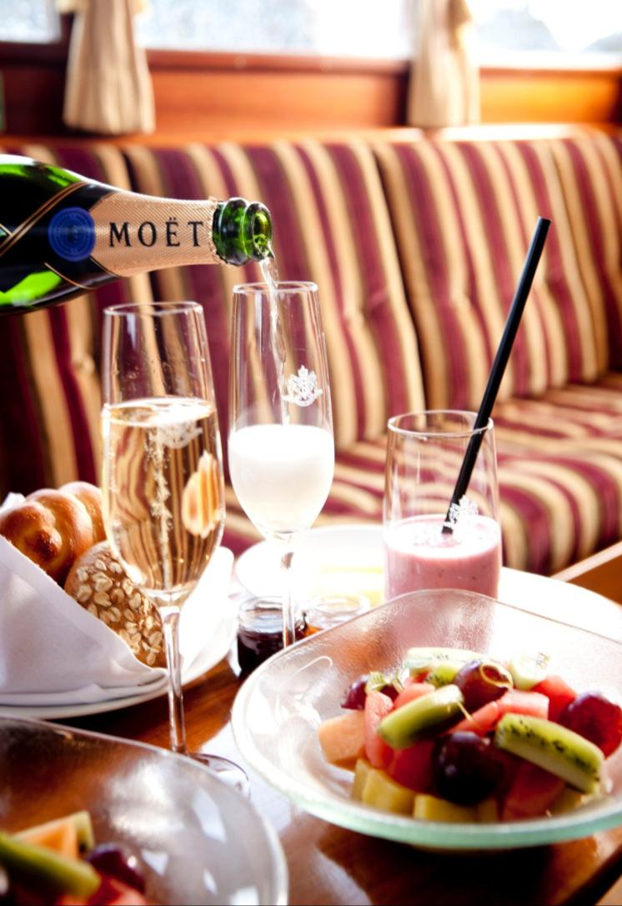
Boat Tour and Catering
Notes:
Hotel has its own boats which can be used for tours, presentations, pick ups etc. Catering on board is possible as well.

Slide 17
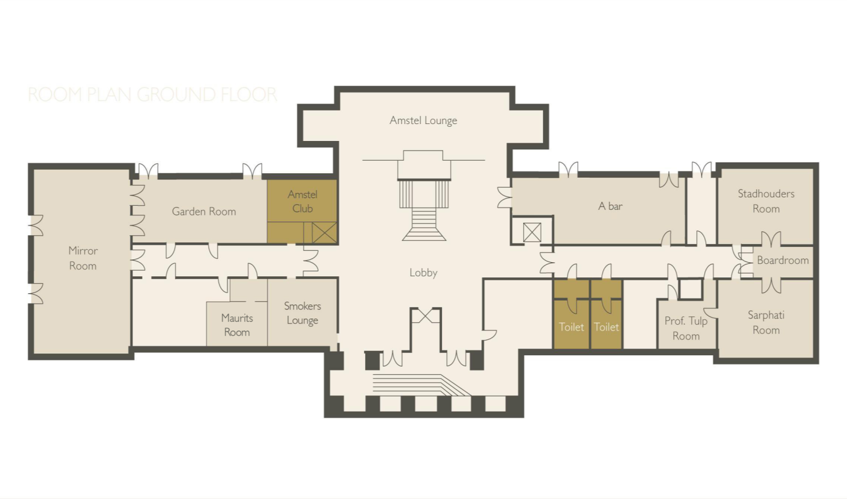
AMSTEL RIVER
Van Gogh 125
Over 400 years of history
Room Plan

Slide 18
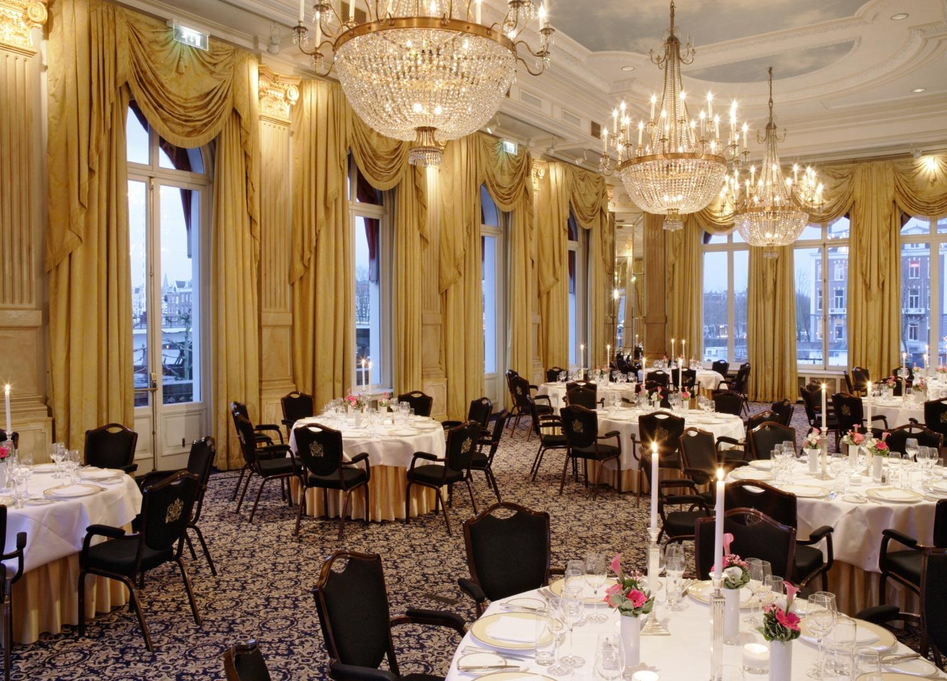
Mirror Room

Slide 19
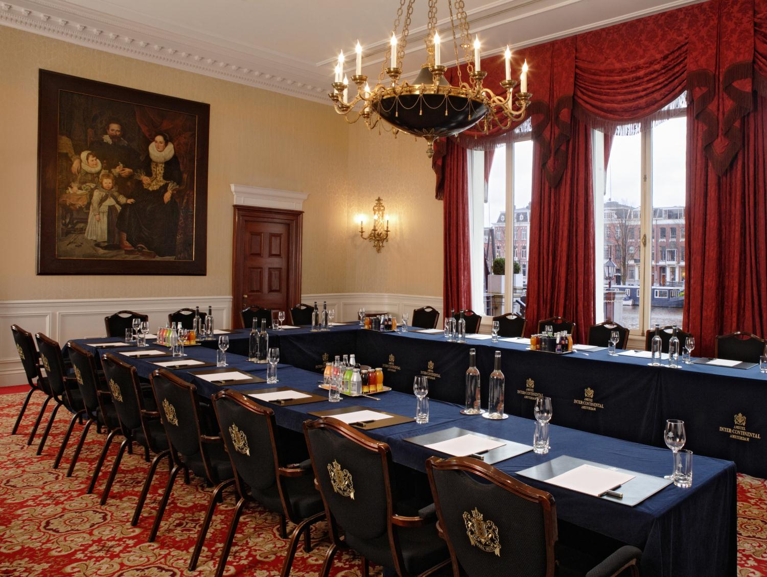
Stadhouders Room

Slide 20
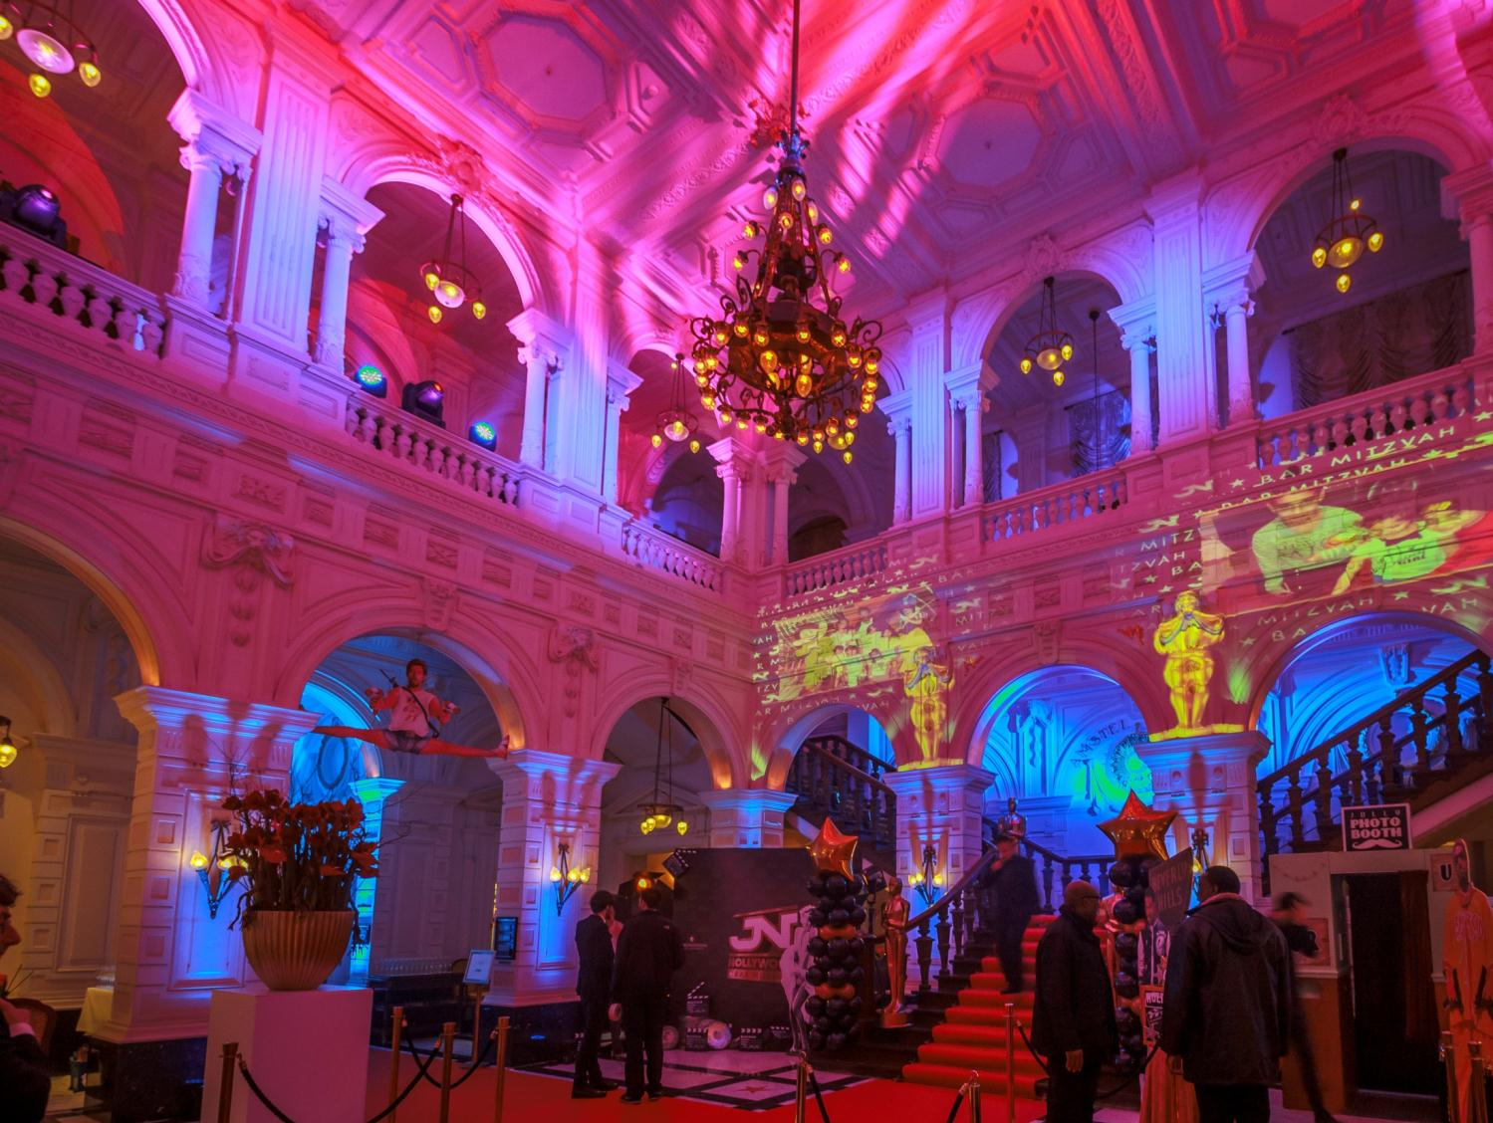
Lobby

Slide 21
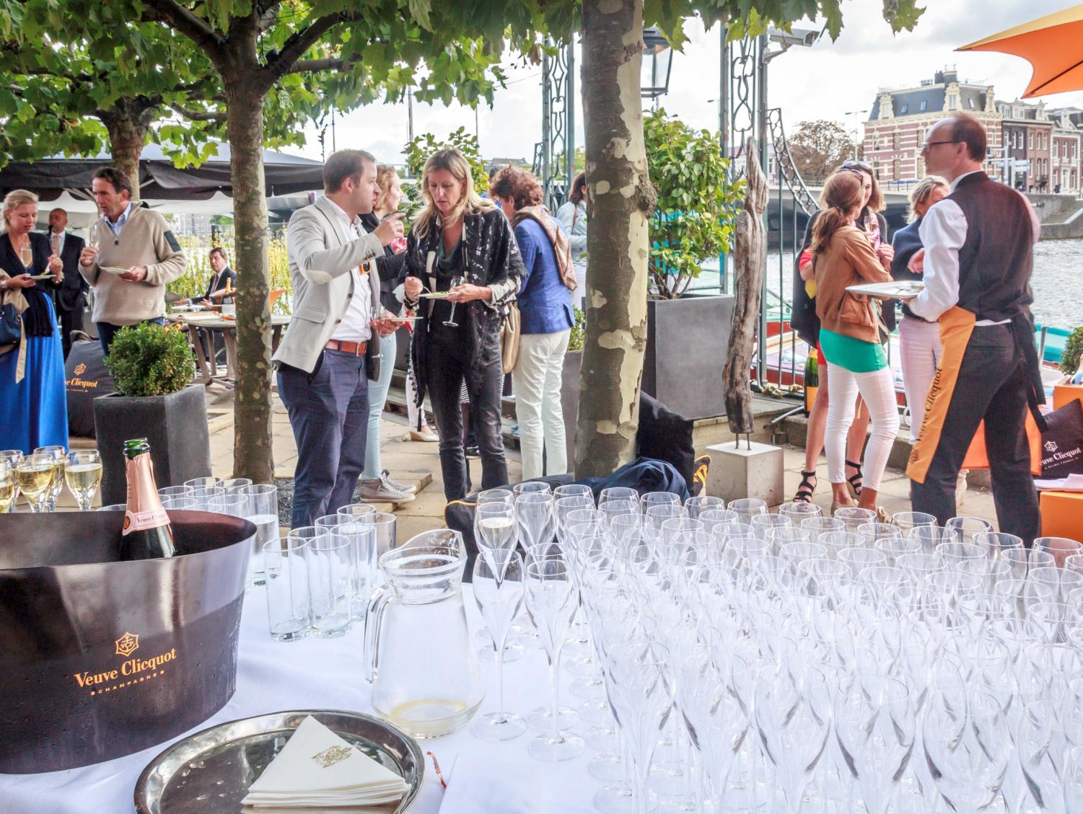
Terrace event

Slide 22
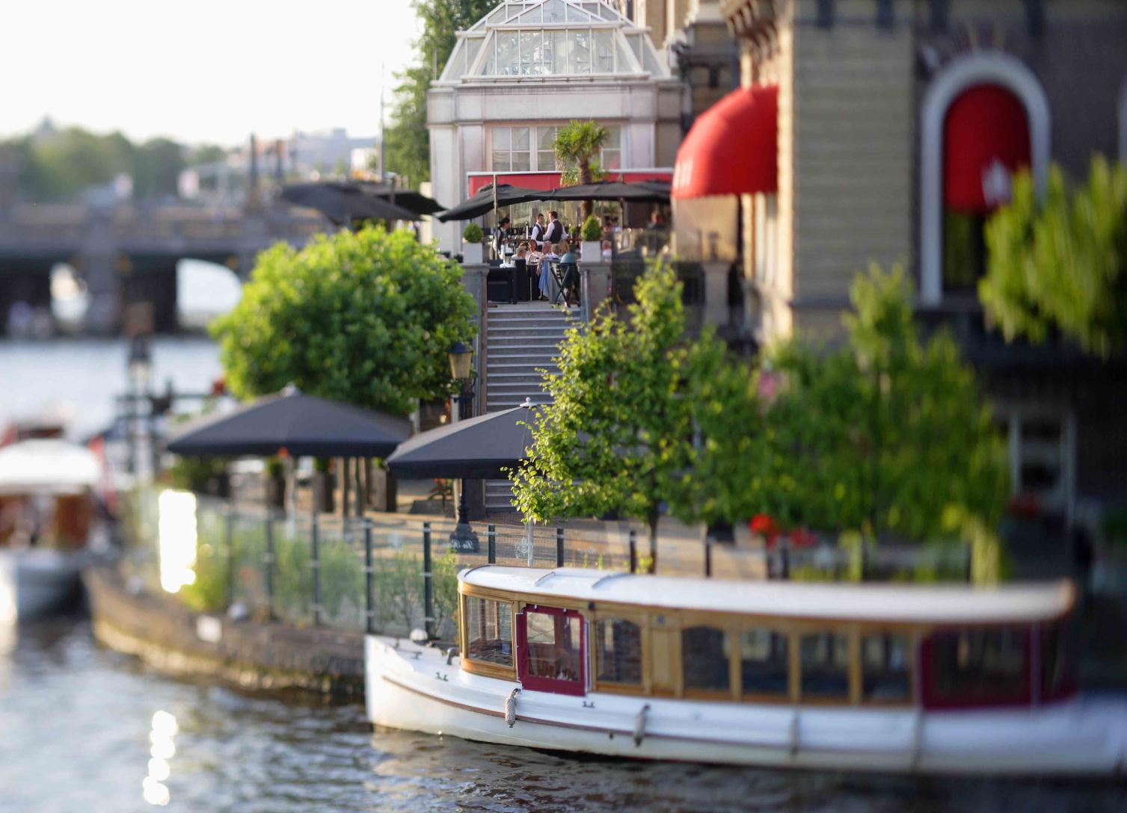
THANK YOU

